Slide 1
American Sign language translator
By: Geoffrey Anto Ignatius E
21BPS1388

Slide 2
PROBLEMs
To visualize deep learning
Communication gap Between people
Apply Deep-Learning in real world and to relish the astonishing results
Many of us are generally not familiar with sign Languages
Lack of computation power in web
The computation power available in web apps are comparatively lower and thus making model prediction in web is not efficient

Slide 3
SOLUTION
Display using a website or a application
Make translators to reduce communication gap
Deep Learning can be done in any language as its not a related to a specific programming language but a concept
For Example A Real Time Translator using deep learning and deployed on a Web Application
Make the model efficient
Reduce the number of parameters and the Input shape of the images
(See Slide 20)

Slide 4
Technical details
Deep - Learning
Web - Application
USED TENSORFLOW AND KERAS FOR DEEP-LEARNING AND MAKING THE MODEL.
THE MODEL USED IN THE WEB APP WAS CONVERTED TO JS MODEL FROM KERAS MODEL
USED REACT WITH TENSORFLOWJS FOR THE FRONTEND AND INPUT ANALYSIS OF THE WEB CAMERA FRAMES
THE PREDICTIONS ARE PREFORMED OFFLINE ON THE USERS COMPUTER
The Challenging part was Making predictions due to the Async Nature of JavaScript and the scarce Resources for TensorflowJS 😥

Slide 5
Deep - learning
Done With:
Python
Numpy
Matplotlib
Tensorflow
Keras
PIL

Slide 6
What is Machine – learning?
Machine - Learning
Supervised Learning
Machine learning is an application of artificial intelligence (AI) that provides systems the ability to automatically learn and improve from experience without being explicitly programmed. Machine learning focuses on the development of computer programs that can access data and use it to learn for themselves.
This machine leaning algorithm is nothing but a self learning algorithm with makes use of the data in forms of these numbers and preform several computation(Operations) to find patterns and relation in these data and learns through its mistakes, This is called a supervised learning where the algorithm knows its mistakes/how wrong its from the original values.
How do we define it in terms everyone can understand?
Machine learning is a computer program/an algorithm when fed with a lot of data in form of numbers finds patterns and similarity in those data and make predictions for that data.

Slide 7
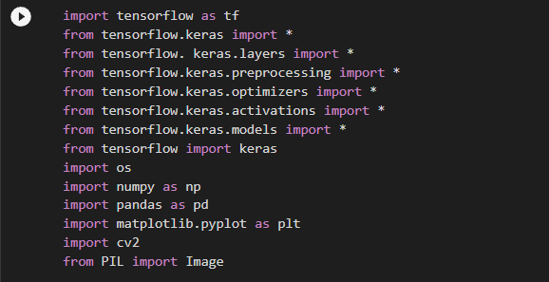
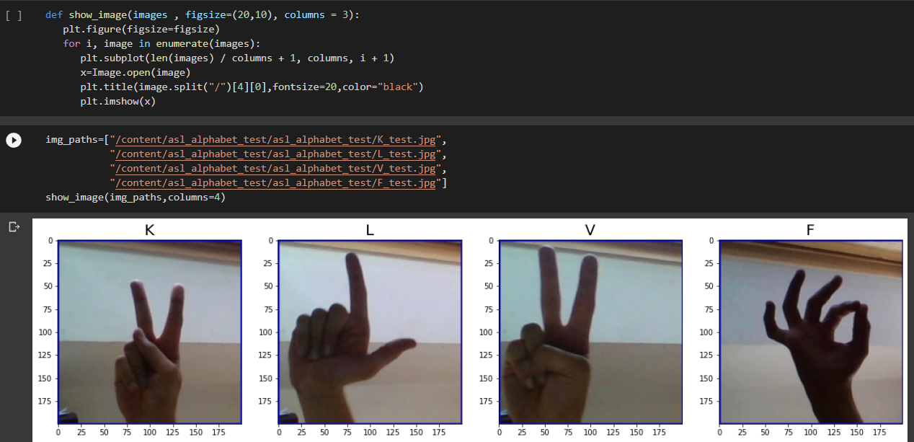
Importing The Modules
Visualizing The Images

Slide 8
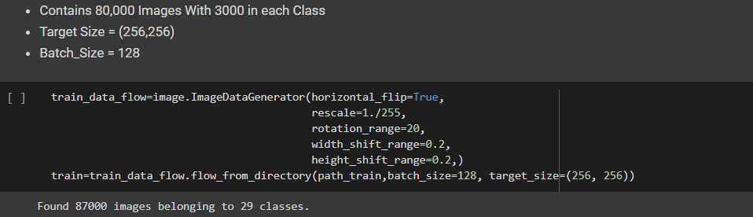
Make A Data Generator
Now We Are Done With Importing The Data

Slide 9
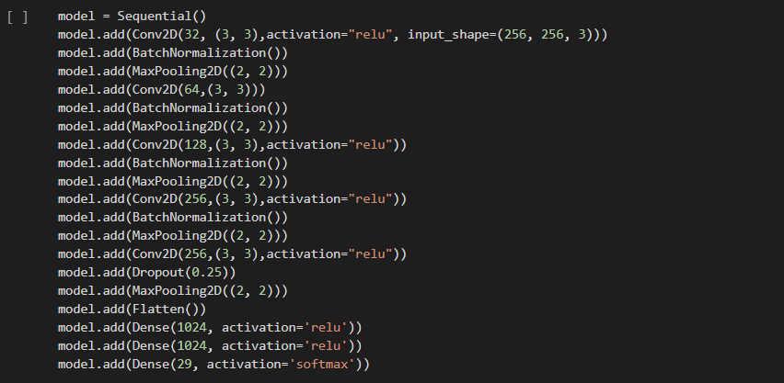
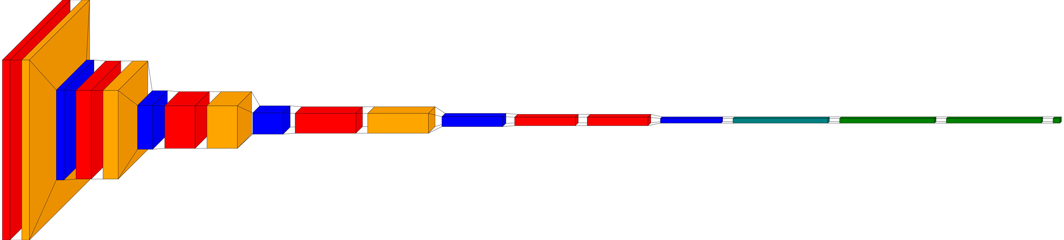
The Deep – Learning Model
Model Architecture

Slide 10
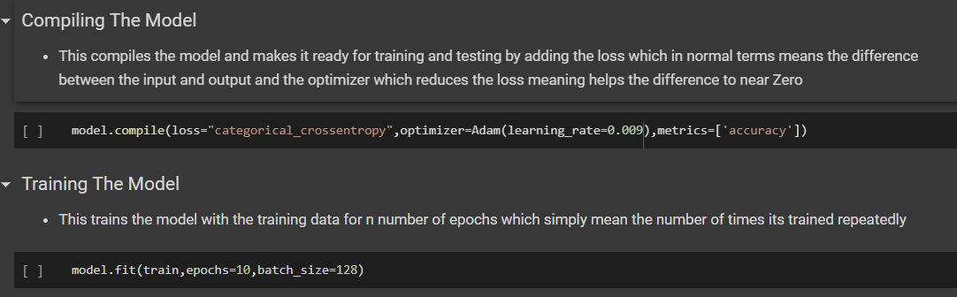
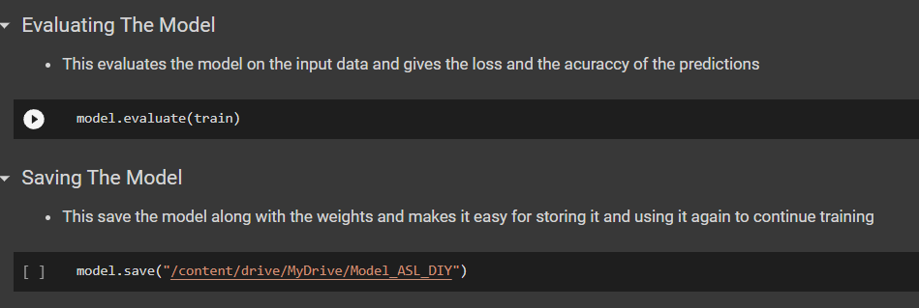
Model Training
Model Evaluation And Saving It To Local Storage

Slide 11

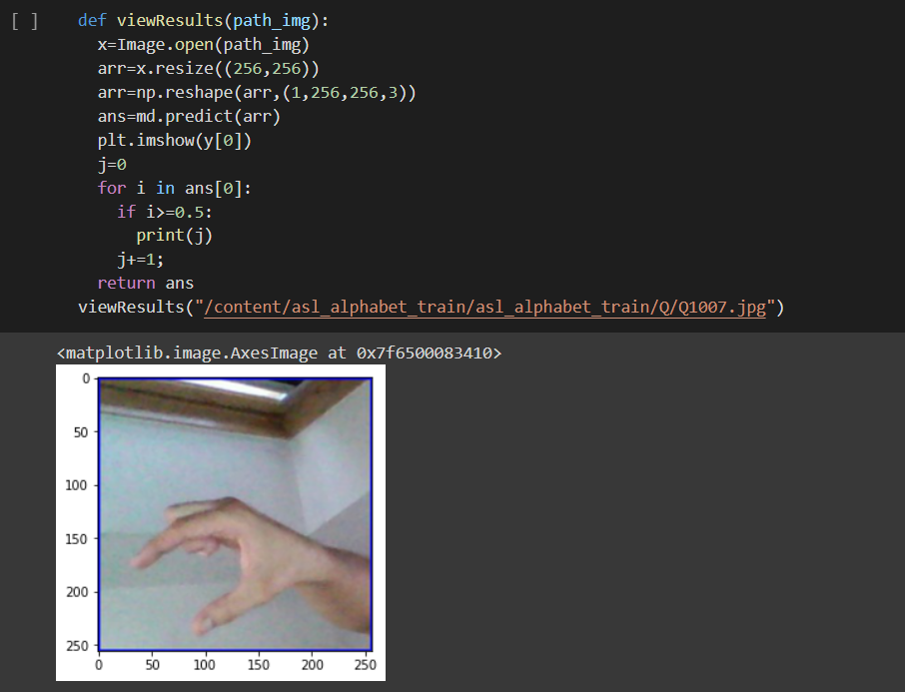
Converting Keras Model To TfJs Model
Visualizing The Results With The Images From The Dataset And Predicting The Output

Slide 12
Why not More?
Why not visualize The results in Real Time?
Why Not Make The Results Available For Everyone?
Why Not Make It Easy For People To Understand?
I Thought About How To Proceed Then Came Up With An Idea To Make A Web – Application To Display The Astonishing Results Of Deep – learning
In The Next Few Slides We Will See About The Development Of The Web – Application And The Struggles I Overcame

Slide 13
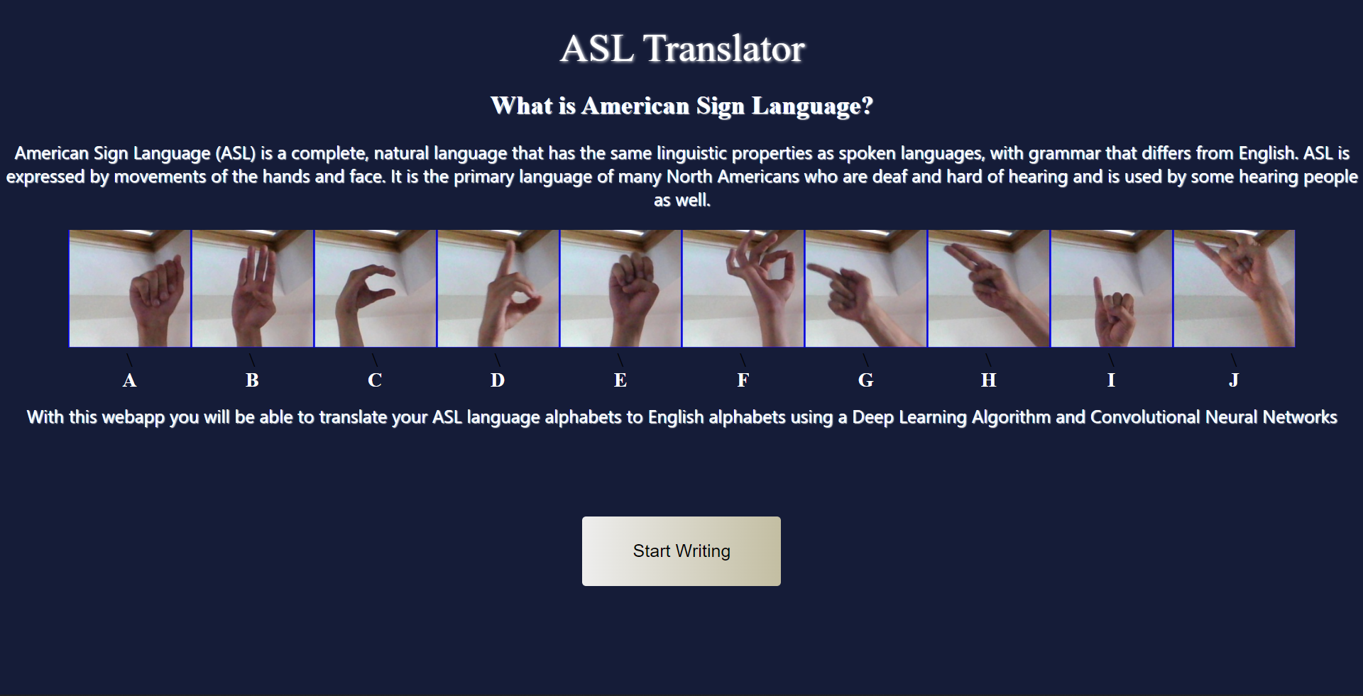
ASL Translator - Web Application

Slide 14
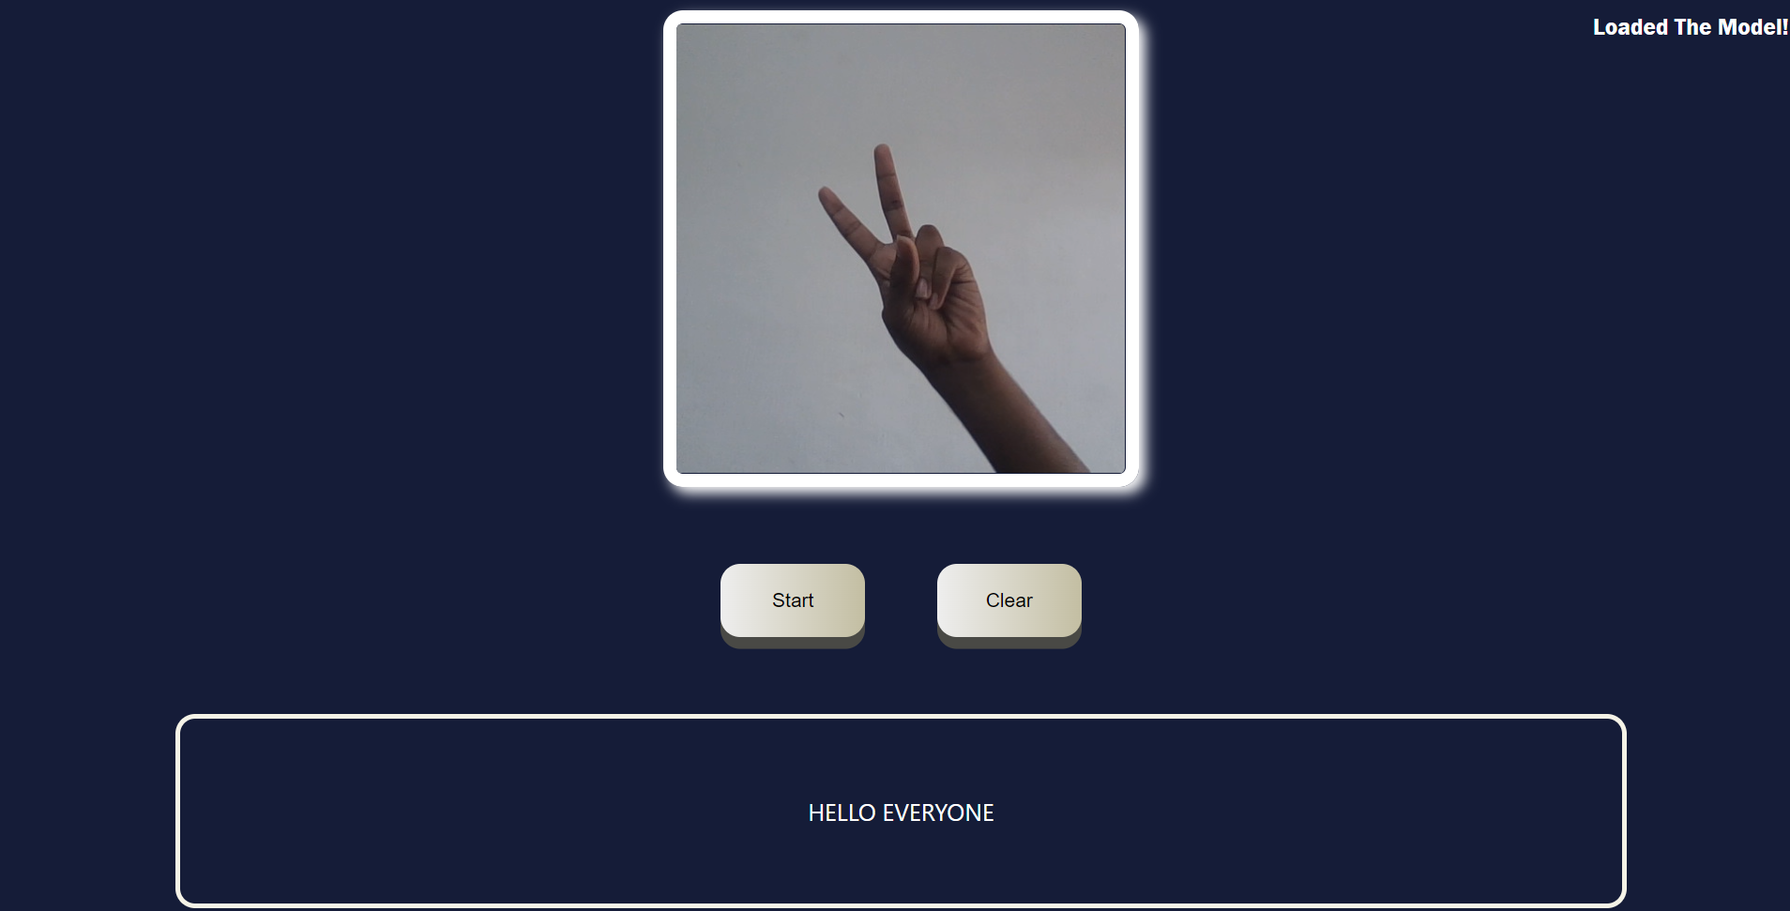
HELLO EVERYONE ;)

Slide 15
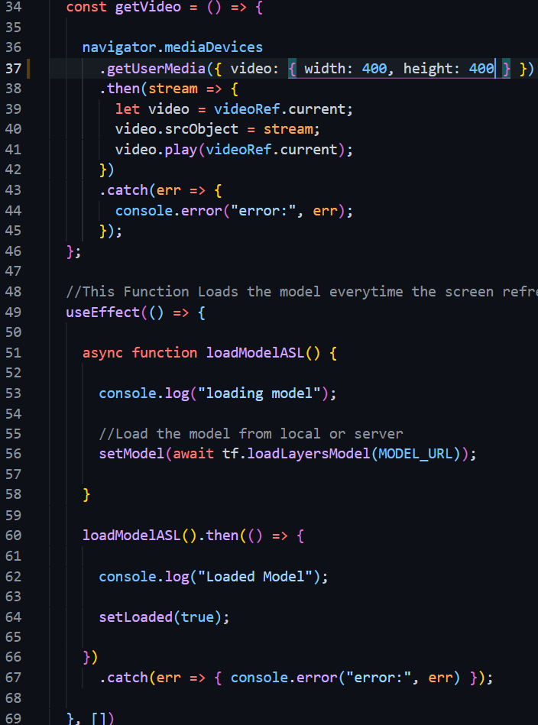
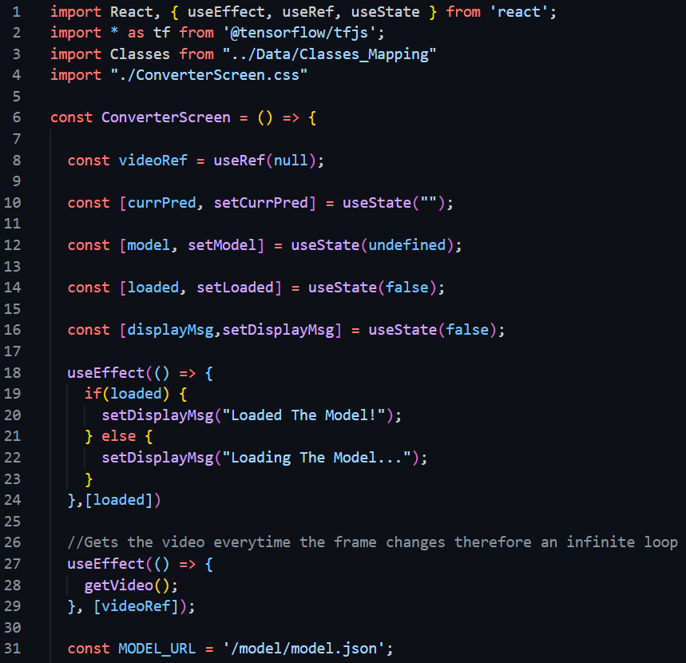
The Main Code :)

Slide 16
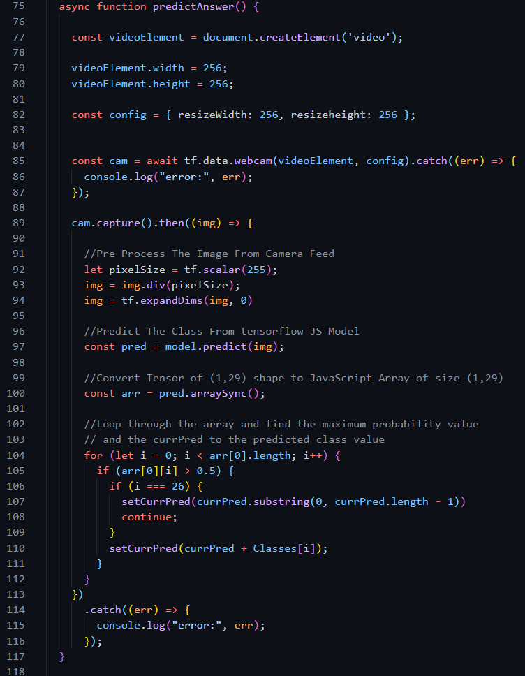
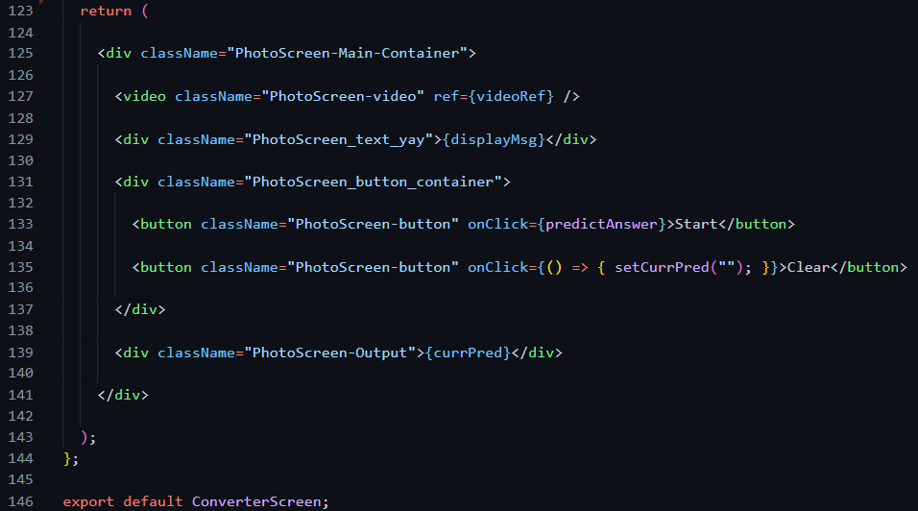

Slide 17
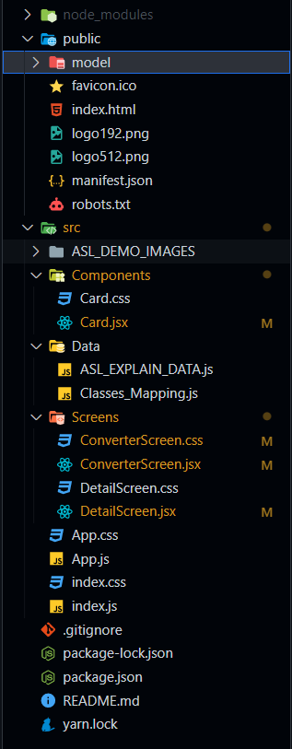
Code Structure / explanation
The Web Application Was Created Using ReactJS
TensorflowJS Used For Image Pre-Processing, Loading The Machine Learning Model, Making Predictions using that model
Model Located in App->public->model
First Screen in App -> src -> Screens -> DetailScreen.jsx (css -> FileName.css)
Second Screen in App -> src -> Screens -> ConverterScreen.jsx (css -> FileName.css)
Application Entry Point Index.js

Slide 18
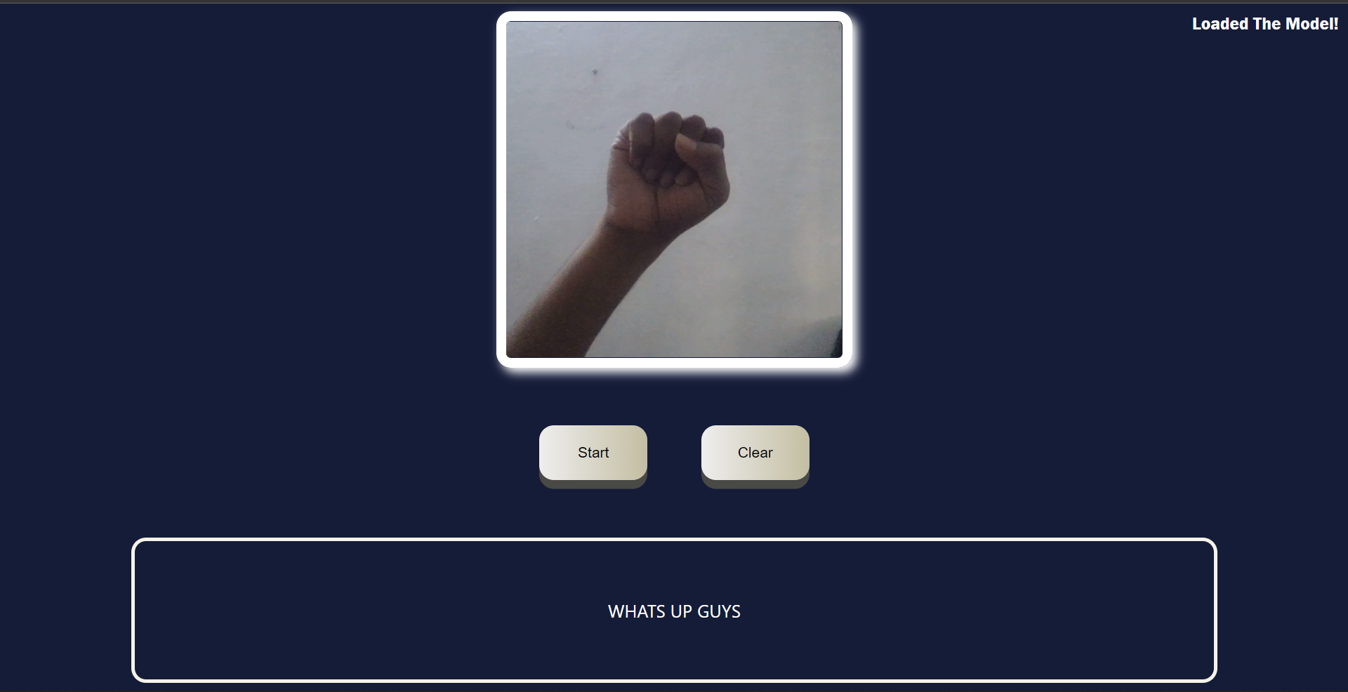
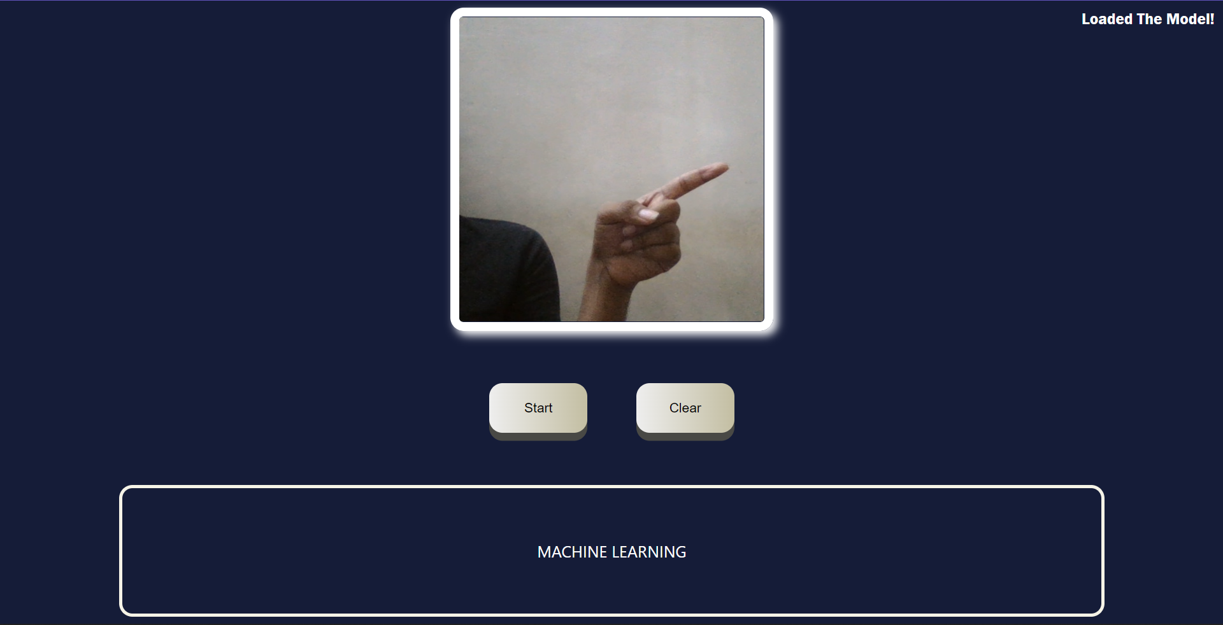
More Outputs :)

Slide 19
Thus We Solved Most Of The Real World Problems Mentioned In Slide 2 About The Communication Gap And Visualize The Results.
But The Website Doesn’t Update Realtime But Only Translates When We Press A Button
This Was Because Of The Time Taken For The Model To Predict The Result (One Forward Pass) And Thus Making It Run Automatically Makes The Website Lag And Sometimes Cause Error.
To Reduce The Layers/Input Shape… But It Will Lead To A Loss In Accuracy.
To Make The Prediction Online Meaning A Server But That Would Also Take Up More Time As There Is A 2-way Data Transfer.

Slide 20
My Solution For The Model Efficiency Problem
Points Proposed
Base Model Which Can Differentiate Between Alphabets.
Transfer Learning To Cloud Model With Tensorflow And Keras.
Hand Mapping Of The User And A Model To Find Similarity Between Them
A U-net Architecture Or Maybe A Res-net Architecture For Combining These Two Models.
The Most Meaningful Way To Increase Efficiency Would Be To Make A Base Light Weight Model And To Slowly Train It For The Users Hand (Specific Features Of The Users Hand) Locally With His Or Her PC/Mobile On A Cloud Model Which Would Make A Robust Model And Increase Accuracy On The Long Run.

Slide 21
That’s All is Possible???
A Big No!!!
What If A Person Who Has Speaking Issues Wants To Communicate With A Person With Eyesight Problem?🤔
No Worries!, We Can Make The DL Algorithm Which Can Convert Picture To Speech And Vice Versa.
What If We Want To Translate A Song To Sign Language?🤔
That’s Also An Yes!, We Can Use Generative Adversarial Models To Produce Images For The Corresponding Song.

Slide 22
So What Do We Learn By This?
We Learn That There Is No Limit On What We Can Be Done With This Field Of Machine Learning But The Limit Lies On One’s Thoughts And Ideas.
We Don’t Use Brick To Show It Off, But To Use It And Build Something Useful Like A House And Show Off That House
Thus The Importance Of Do It Yourself Projects Is Not Mostly About Showcasing Your Talents But About How You Use These Talents To Find A Solution For A Idea And Show That Off.

Slide 23
THANK YOU :)

